Slide 1
HTTP and APIs
AI2C Techs

Slide 2
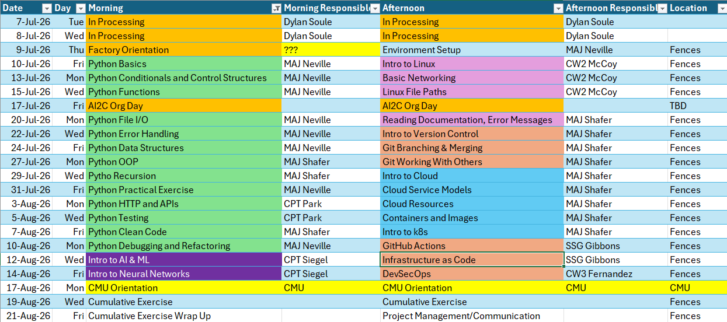
Course Schedule

Slide 3
Lesson Objectives
Implement HTTP request handling
Understand and implement API calls
Understand HTTP authentication schemes
Notes:
https://www.rfc-editor.org/rfc/rfc1945

Slide 4
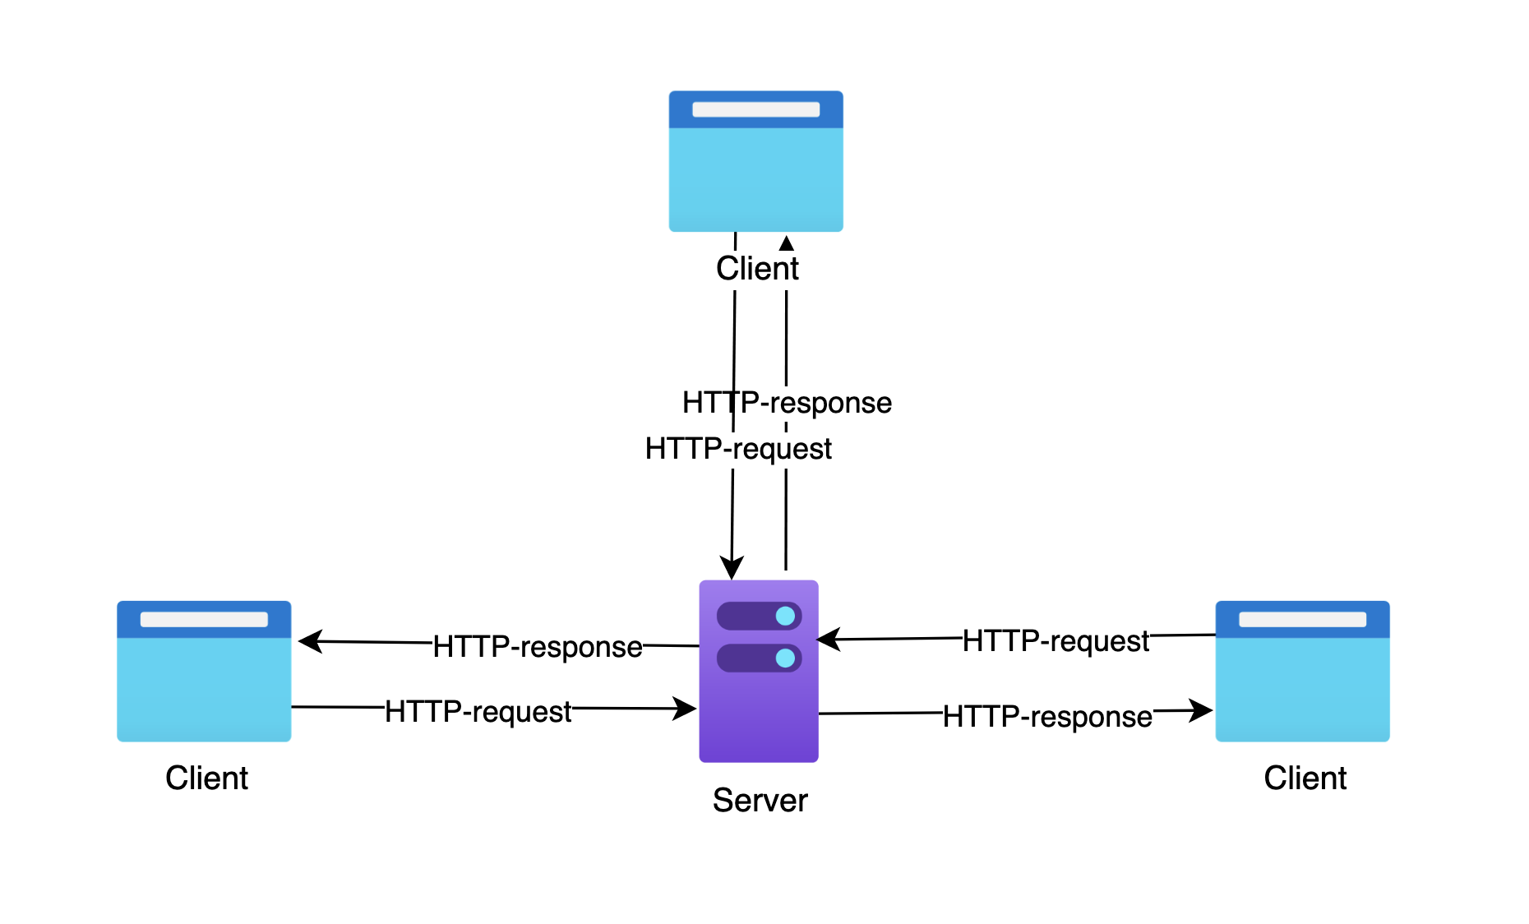
HyperText Transfer Protocol (HTTP)
Specified in RFC 1945 (May 1996!)
Consists of clients, servers, requests, and responses
"The language of the web"
Improvements and modifications over time
Notes:
https://www.rfc-editor.org/rfc/rfc1945

Slide 5
The HTTP Protocol: Rules
Client (i.e., browser) always initiates
Server responds, is always listening
One request, one response: Each HTTP exchange is complete
Stateless: Server doesn't remember previous requests (hence cookies needed)
Notes:
HTTP has four fundamental rules that govern how communication works. First, the client always initiates. Browsers start every conversation. Second, the server always responds. It must reply to every request, even if just to say 'error'. Third, it's one request, one response. Each HTTP exchange is complete in itself. Fourth, and most importantly, HTTP is stateless - the server doesn't remember previous requests. This is why cookies exist. Without them, you'd have to log in for every single page you visit.

Slide 6
Examples
Line
Headers
Body
Request
Response
GET /test HTTP/1.1\r\n
Host: example.com\r\n
Accept: */*\r\n
\r\n
{"param"="hello"}\r\n
HTTP/1.1 404 Not Found\r\n
Server: Apache/2.0.52\r\n
Accept-Ranges: bytes\r\n
Content-Length: 2652\r\n
Content-Type: text/html;\r\n
\r\n
<!doctype html><html ...
Notes:
GET /test HTTP/1.1
Host: example.com
Accept: */*
{"param"="hello"}

Slide 7
Methods and Codes
Core Request Methods
Response Status Code
GET – request data from server
POST – submit data to the server
PUT – replace data in the server
DELETE – remove specified resource from the server
Status-Code= "200" ; OK
| "201" ; Created
| "202" ; Accepted
| "204" ; No Content
| "301" ; Moved Permanently
| "302" ; Moved Temporarily
| "304" ; Not Modified
| "400" ; Bad Request
| "401" ; Unauthorized
| "403" ; Forbidden
| "404" ; Not Found
| "500" ; Internal Server Error
| "501" ; Not Implemented
| "502" ; Bad Gateway
| "503" ; Service Unavailable
| extension-code
Successful Connection
(Some) Other Request Methods
Redirection
HEAD – only returns with the headers, no content
TRACE – send back exactly what the server received (good for diagnostics)
Extension methods – custom or protocol-specific verb
Client Error (you)
Server Error (them)
https://developer.mozilla.org/en-US/docs/Web/HTTP/Reference/Status
Notes:
https://www.rfc-editor.org/rfc/rfc1945#section-5
200 everything is good to go
300 go away, this isn’t here
400 you probably made an error
500 the server messed up

Slide 8
HTTP Tools
telnet: A text-based terminal tool.
wget: A command-line utility optimized for downloading files.
curl: The industry-standard command-line tool.
postman: A user-friendly, graphical application.
requests: A popular, elegant Python library.
Wireshark: A powerful network packet analyzer.
Browser (dev tools too!): built-in Developer Tools (Network Tab).
Demo
Notes:
Hit an HTTP that returns HTML and one that returns a JSON response
“You are just sending and receiving text” Maj Shafer

Slide 9
In python
Uses the requests library
https://docs.python-requests.org/en/latest/user/quickstart/#make-a-request
Demo

Slide 10
More Than Text
Have you ever seen an image online?
Have you ever seen a video?
Other formats??

Slide 11
Encoding Text
Remember all data is binary
Computer must represent data consistently
An encoding specifies the data representation
Character | UTF-8 (Binary) | Windows-1252 (Binary) | UTF-16LE (Binary)
A | 01000001 | 01000001 | 01000001 00000000
é | 11000011 10101001 | 11101001 | 00101001 00000110
€ | 11100010 10000010 10101100 | 10000000 | 00001010 00100000
" | 11100010 10000000 10011100 | 10010100 | 01000000 01001111

Slide 12
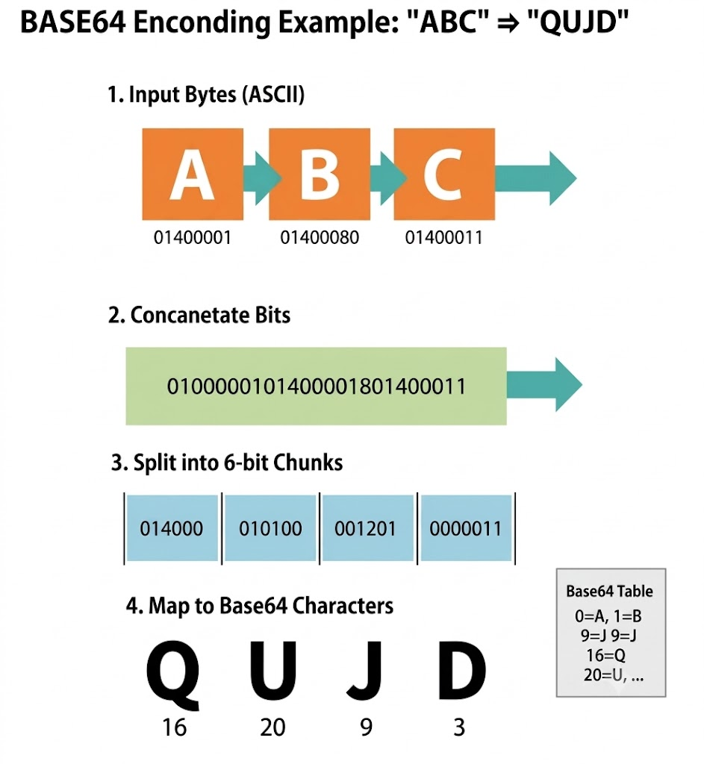
Base64 Encoding
Common HTTP encoding type
Converts every 6 bits into a character (2^6 options…)
A-Z
a-z
0-9
/+
Every 3 bytes → 4 characters
Notes:
https://base64.dev/articles/what-is-base64
What you will see online.
Convert everything to bites

Slide 13
Python Base64
Demo converting an image and some text
Notes:
base64.b64encode
base64.b64decode

Slide 14
Hands-On #1

Slide 15
APPLICATION PROGRAMMING INTERFACE (API)
An API is a set of rules and protocols allowing communication.
Analogy:
You (client) are at a restaurant
The kitchen (server/database) preps the food
The waiter (API) takes your order, delivers it to the kitchen, and brings the food back to you.
Notes:
How do two applications talk to each other effectively
GET /test HTTP/1.1
Host: example.com
Accept: */*
{"param"="hello"}

Slide 16
APPLICATION PROGRAMMING INTERFACE (API)
Efficiency: Don’t reinvent the wheel.
Automation: Eliminate manual data entry.
Security: APIs only share the specific data requested.
Scalability: Easy to connect new features, platforms, and services.
Notes:
GET /test HTTP/1.1
Host: example.com
Accept: */*
{"param"="hello"}

Slide 17
API Terms
Path
Query String
Body
Request
GET /users/{user}/playlists?sort={direction} HTTP/1.1\r\n
Host: example.com\r\n
Authentication: "Bearer 1234deadb33f"
Accept: */*\r\n
\r\n
{"genre": "rock"}\r\n

Slide 18
Reading API Docs
PayPal

Slide 19
Reading API Docs
In groups:
Compare two commits in GitHub
Plan a route using Google Maps
See my abandoned carts in Shopify
Create a new Spotify playlist
Per task, identify the following:
Endpoint, e.g. https://api.github.com/repos/{owner}/{repo}/commits
Required parameters (path, body, or query string?)
Optional parameters (path, body, or query string?)
How do they handle multiple responses (e.g. 1000 commits)?
Notes:
GitHub example: Endpoint:
Repos/{owner}/{repo}/compare/{basehead}
Required Parameters:
Path parameters
owner string Required
The account owner of the repository. The name is not case sensitive.
repo string Required
The name of the repository without the .git extension. The name is not case sensitive.
basehead string Required
The base branch and head branch to compare. This parameter expects the format BASE...HEAD. Both must be branch names in repo. To compare with a branch that exists in a different repository in the same network as repo, the basehead parameter expects the format USERNAME:BASE...USERNAME:HEAD.
Optional Parameters:
Page
Per page
Multiple Responses:
To process a response with a large number of commits, use a query parameter (per_page or page) to paginate the results.
When using pagination:
The list of changed files is only shown on the first page of results, and it includes up to 300 changed files for the entire comparison.
The results are returned in chronological order, but the last commit in the returned list may not be the most recent one in the entire set if there are more pages of results.

Slide 20
Authentication
Authorization vs Authentication?
How does a stateless protocol handle authentication?

Slide 21
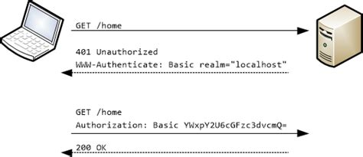
Basic Authentication
username:password
Base64 encoded
Notes:
Pros:
Simple
Stateless
User-specific
Cons;
Sending password repeatedly
Cannot auth 3rd parties
Sent to the system ‘username:password (basic 64 encoded)’

Slide 22
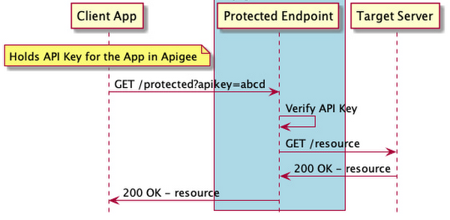
Key/Token Authentication
Notes:
Pros:
Simple
Stateless
Can auth 3rd parties
Cons;
Hard to rotate keys
Generally not user-specific

Slide 23
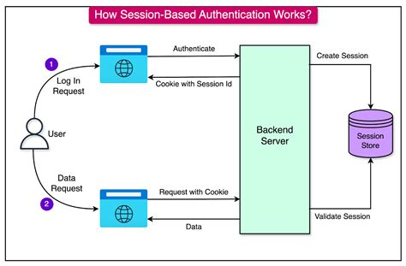
Session Cookies
Notes:
Pros:
Simple
User-specific
Cons:
Stateful
Cannot auth 3rd parties

Slide 24
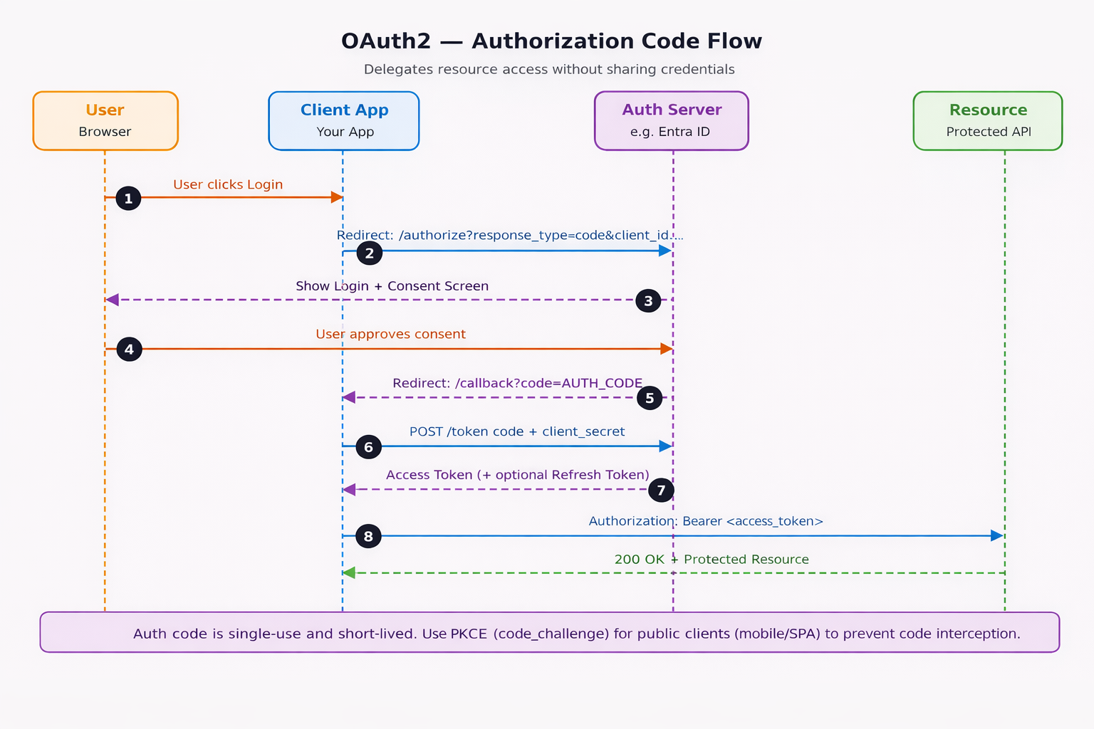
OAUTH
Notes:
Pros:
Limited scope / time
User-specific
Can auth 3rd parties
Cons:
Complexity
https://www.c-sharpcorner.com/article/a-net-developers-complete-guide-to-choose-right-authentication-from-basic-aut/

Slide 25
In General…
How long does the token live?
Who generates the token?
Who maintains (revokes) the token?
What resource is the token for?
Is the token stateless or stateful?
Notes:
https://medium.com/@reddyyashu20/beginners-guide-to-fastapi-openai-chatgpt-api-integration-50a0c3b8571e

Slide 26
Hands-On #2

Slide 27
Questions

